Slide 1
GLOBAL WARMING
NAME
INSTITUTION
COURSE
DATE

Slide 2
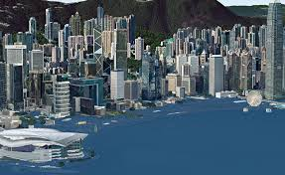
Rising sea levels
Notes:
Sea levels are likely to rise high and cover buildings due to global warming. This is confirmed from United Nations projections by the end of the century. This is if measures to stop global warming are not taken seriously.

Slide 3
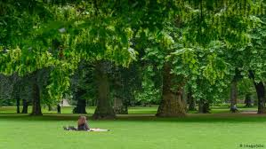
Planting trees
Notes:
Trees should be planted to increase forest cover. Trees release oxygen that keeps the atmosphere cool and refreshed. They also take in carbon dioxide therefore minimizing its percentage in the atmosphere.

Slide 4
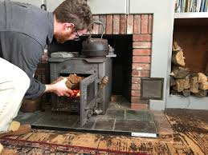
adjusting temperature at home
Notes:
Adjusting temperatures around the house on a cold season contributes to global warming due to the heat emitted. You should therefore stick to dressing warmly during cold days.

Slide 5
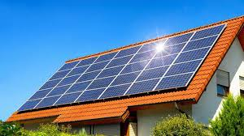
solar energy
Notes:
Solar energy is readily available. This is clean energy that does not have green emissions that pollute the environment unlike fossil fuels. It only needs equipment and installation and is quite dependable as long as there is sufficient sun.

